Slide 1



Slide 2
Somos Amigos/ we are friends/ 我们都是朋友
Please use two to three sentence to introduce yourself in at least two language
Including but not limited to :
Your name
Your Age
The city & Country you are currently resident
What is your favorite things which like to share with our club?
Utilice dos o tres oraciones para presentarse en al menos dos idiomas.
Incluyendo pero no limitado a :
Su nombre
Su edad
La ciudad y el país en el que reside actualmente
¿Cuáles son tus cosas favoritas que te gusta compartir con nuestro club?
请用两三句话介绍你自己，可以包括但是不限制于：
你的名字，
你的年龄
你现在居住的城市和国家
你有什么特别喜爱的事物和大家分享？

Slide 3

Feed Me Smart
Andy Liang, Alex Tang, Junpeng/Mario Zhao, Jonathan Han
https://www.youtube.com/watch?v=haS7dsCwXZs

Slide 4

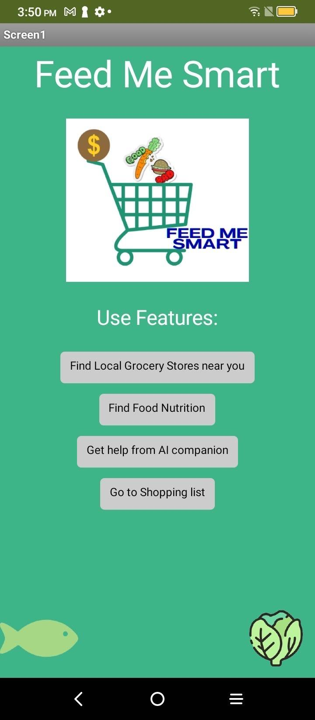
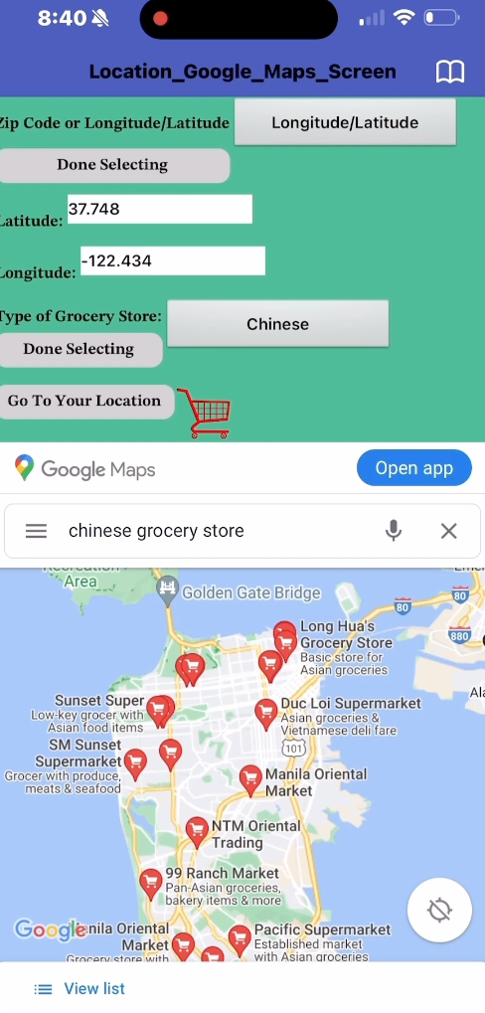
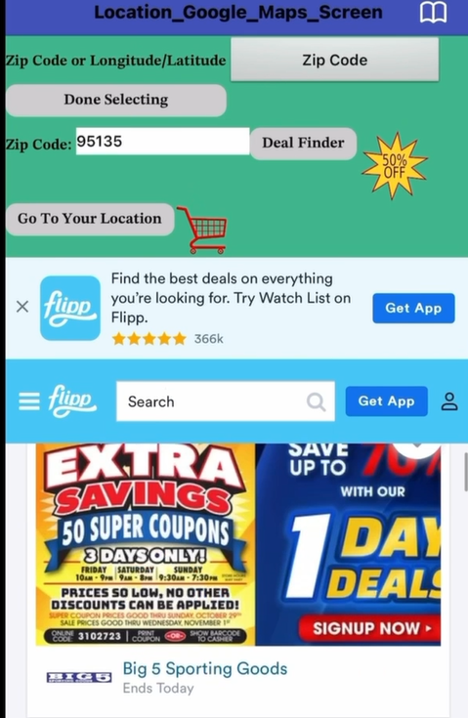
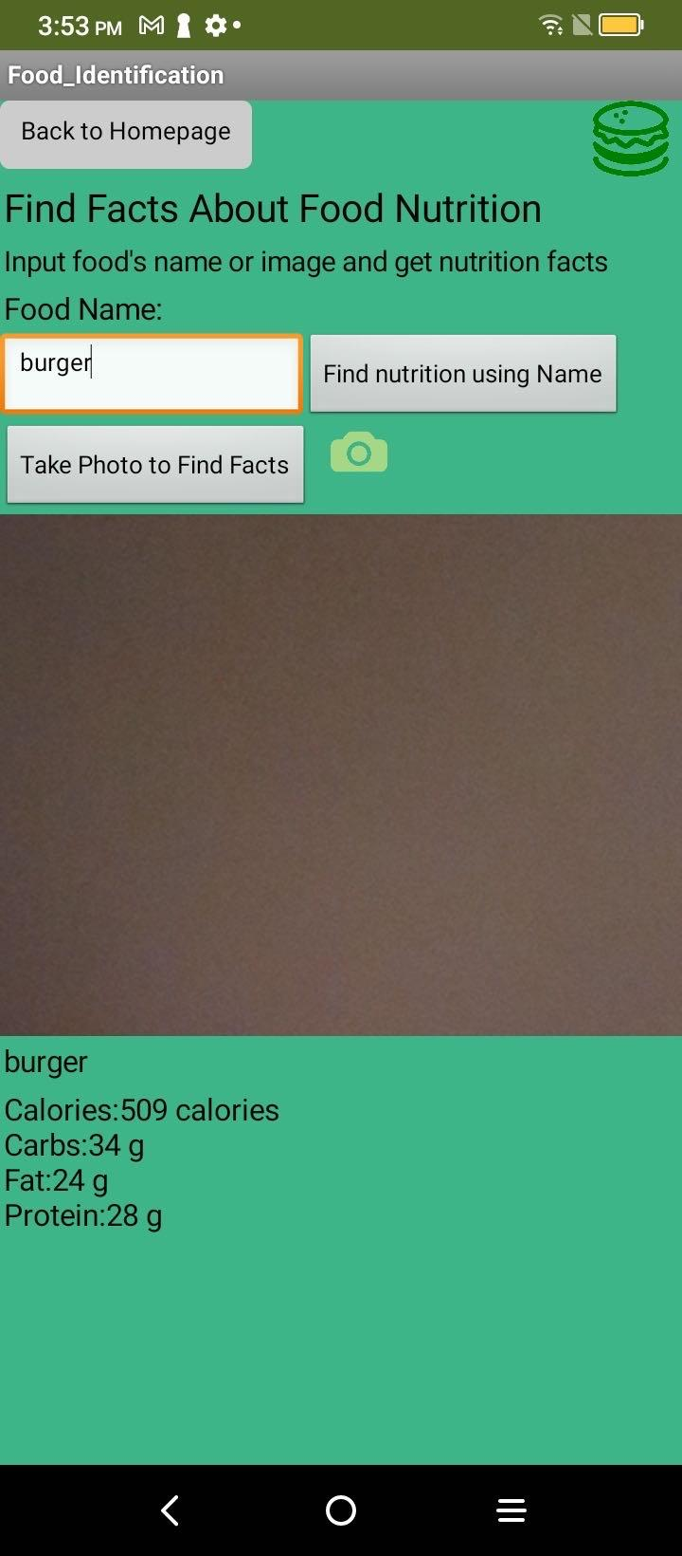
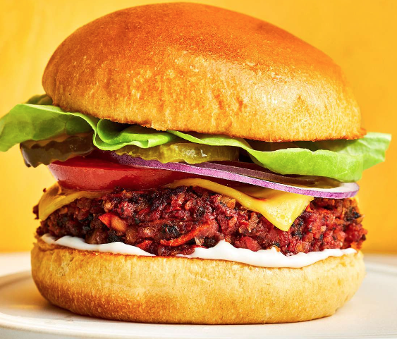
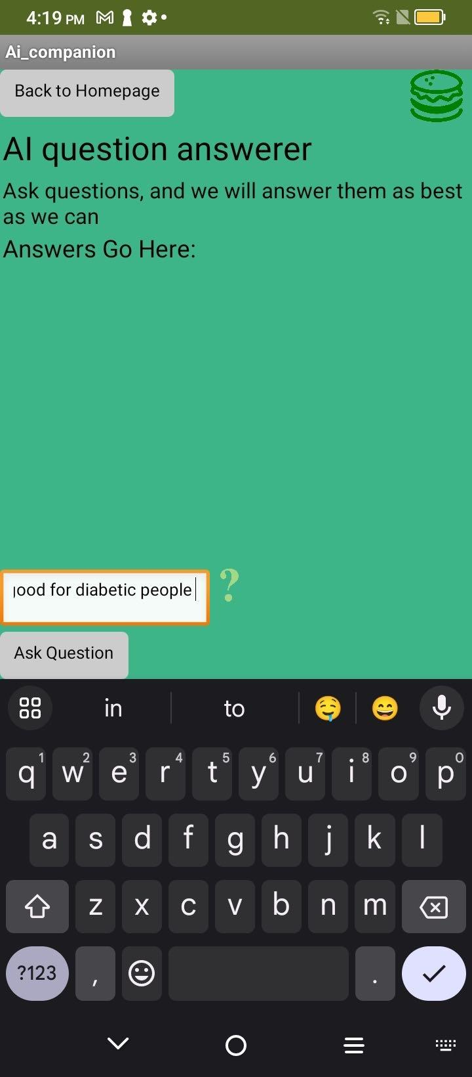
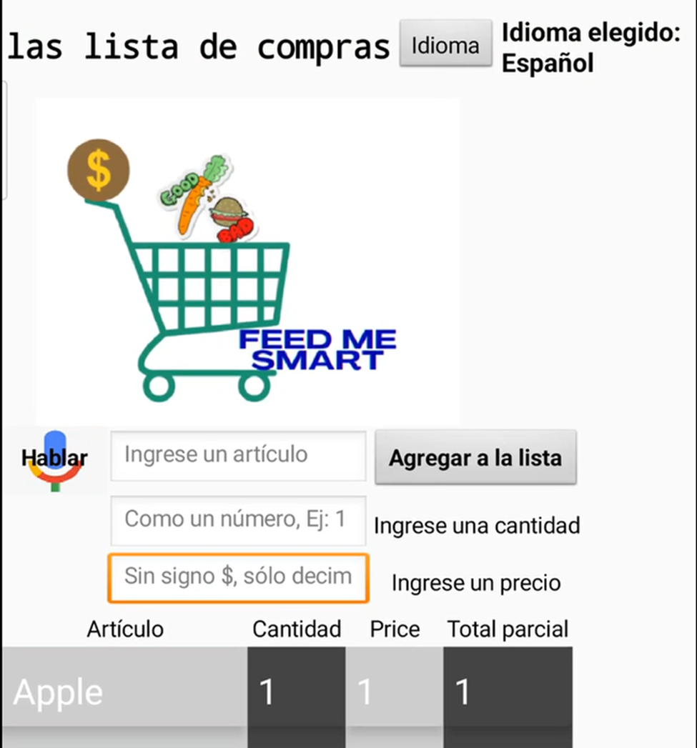
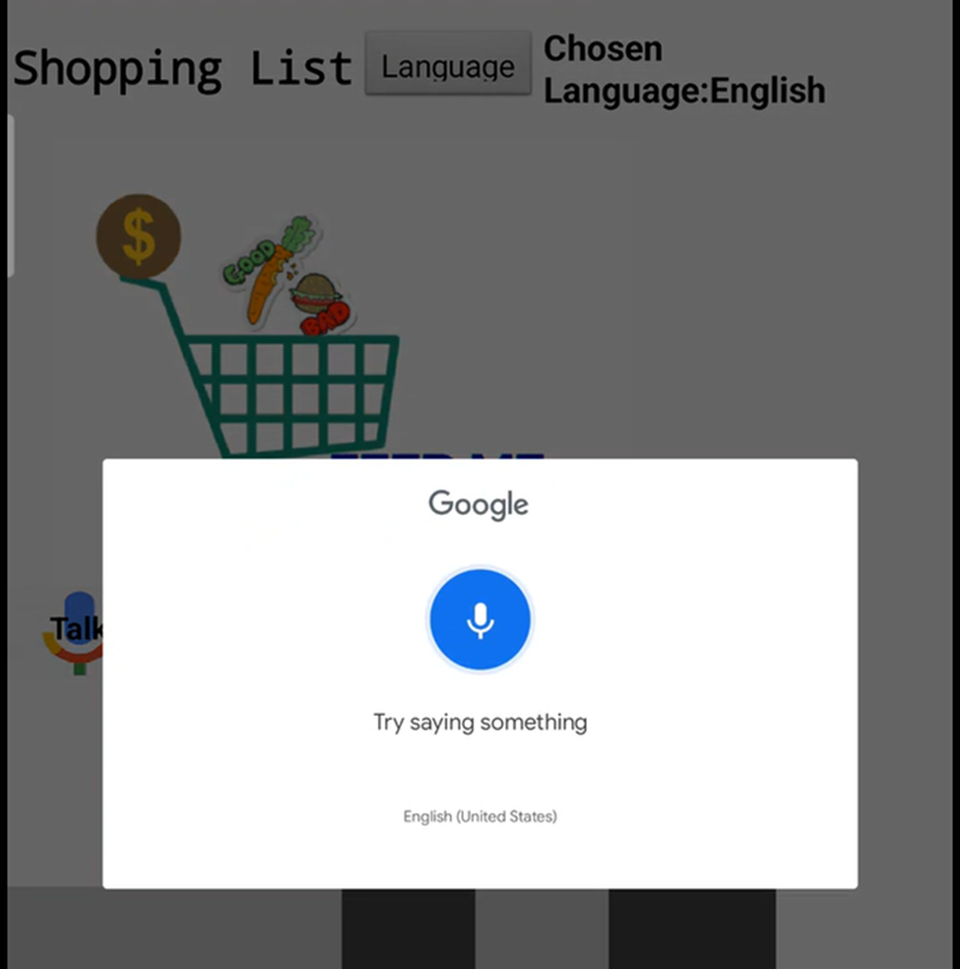
Grocery Store Finder
Food Nutrition Search
find grocery stores by zip code
filter store by food
culture preference
find weekly store deals
scan a picture of a food item to get nutrition facts
learning about food nutrition empowers immigrants to create balanced and healthy meals
AI Companion
Shopping List
create shopping list
  allows users to calculate the cost of their grocery list
users can use voice recognition (supports different languages) or can use text
AI chatbot provides
solutions to any:
  questions
  concerns
  confusions

Slide 5
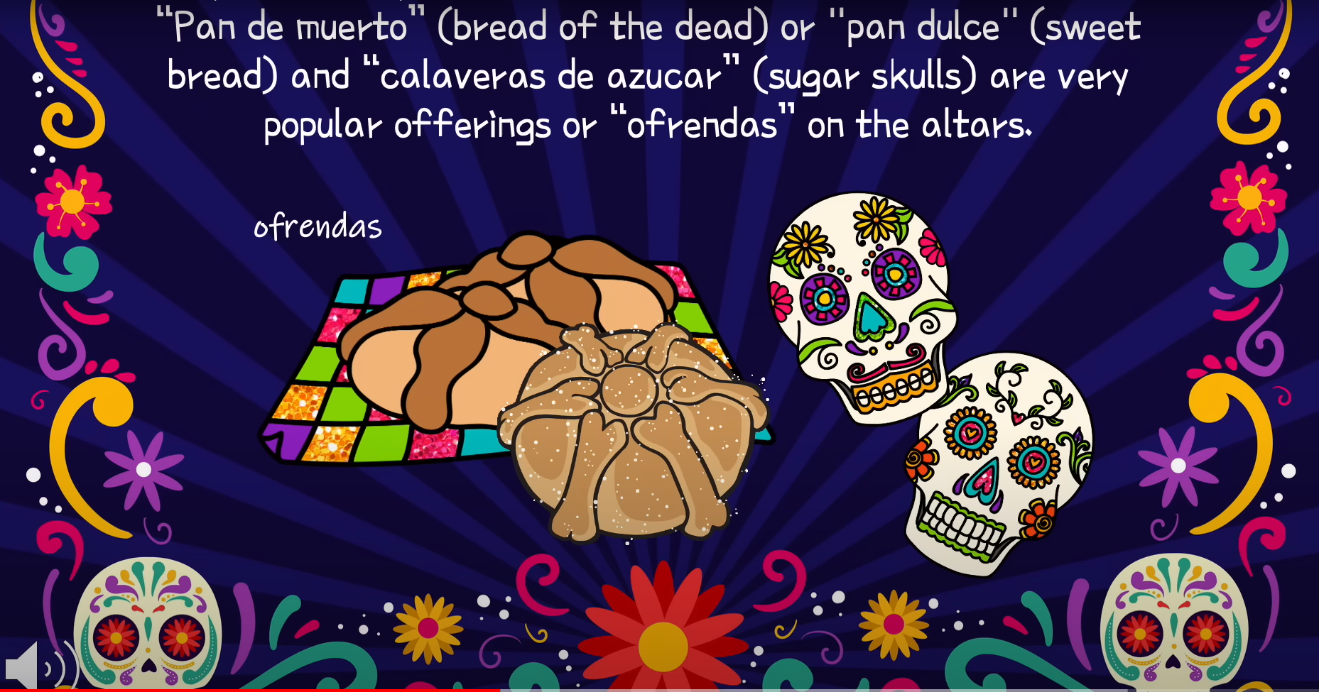
Día de los Muertos
Día de los Muertos
is a celebration honoring the deceased that takes place in Mexico and other parts of Latin America on Nov. 1 and 2.
The holiday is celebrated through ritual observations like constructing altars, ofrendas, filled with offerings to the dead and decorating family gravesites to commune with the dead. It is also commemorated through fiestas in which communities gather to celebrate by dancing, playing music, feasting, drinking and masquerading as death.
"The beautiful thing about Día de los Muertos is that it allows the pain and difficulty [of death] to be transformed through joyous celebration so that it's not about just sitting in the difficulty of death,"
https://www.youtube.com/watch?v=LijduaiSnQY

Slide 6
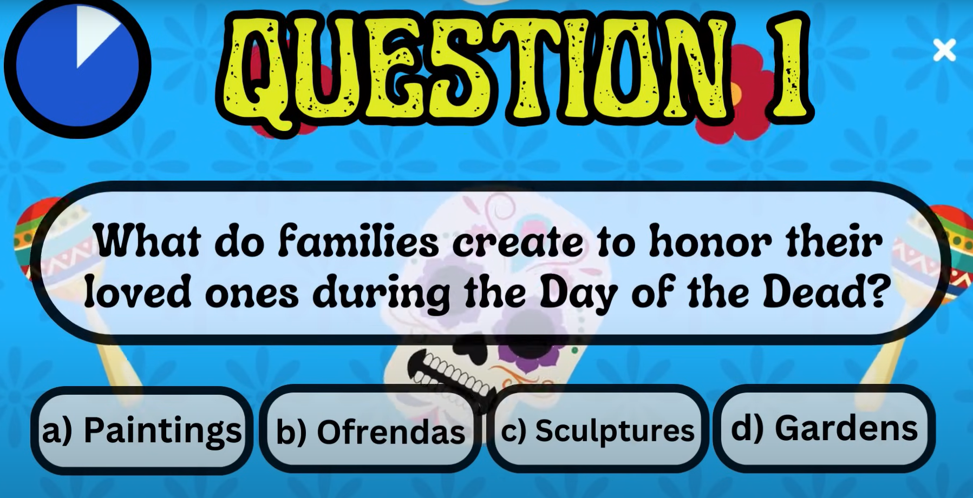
Día de los Muertos
Día de los Muertos

Slide 7
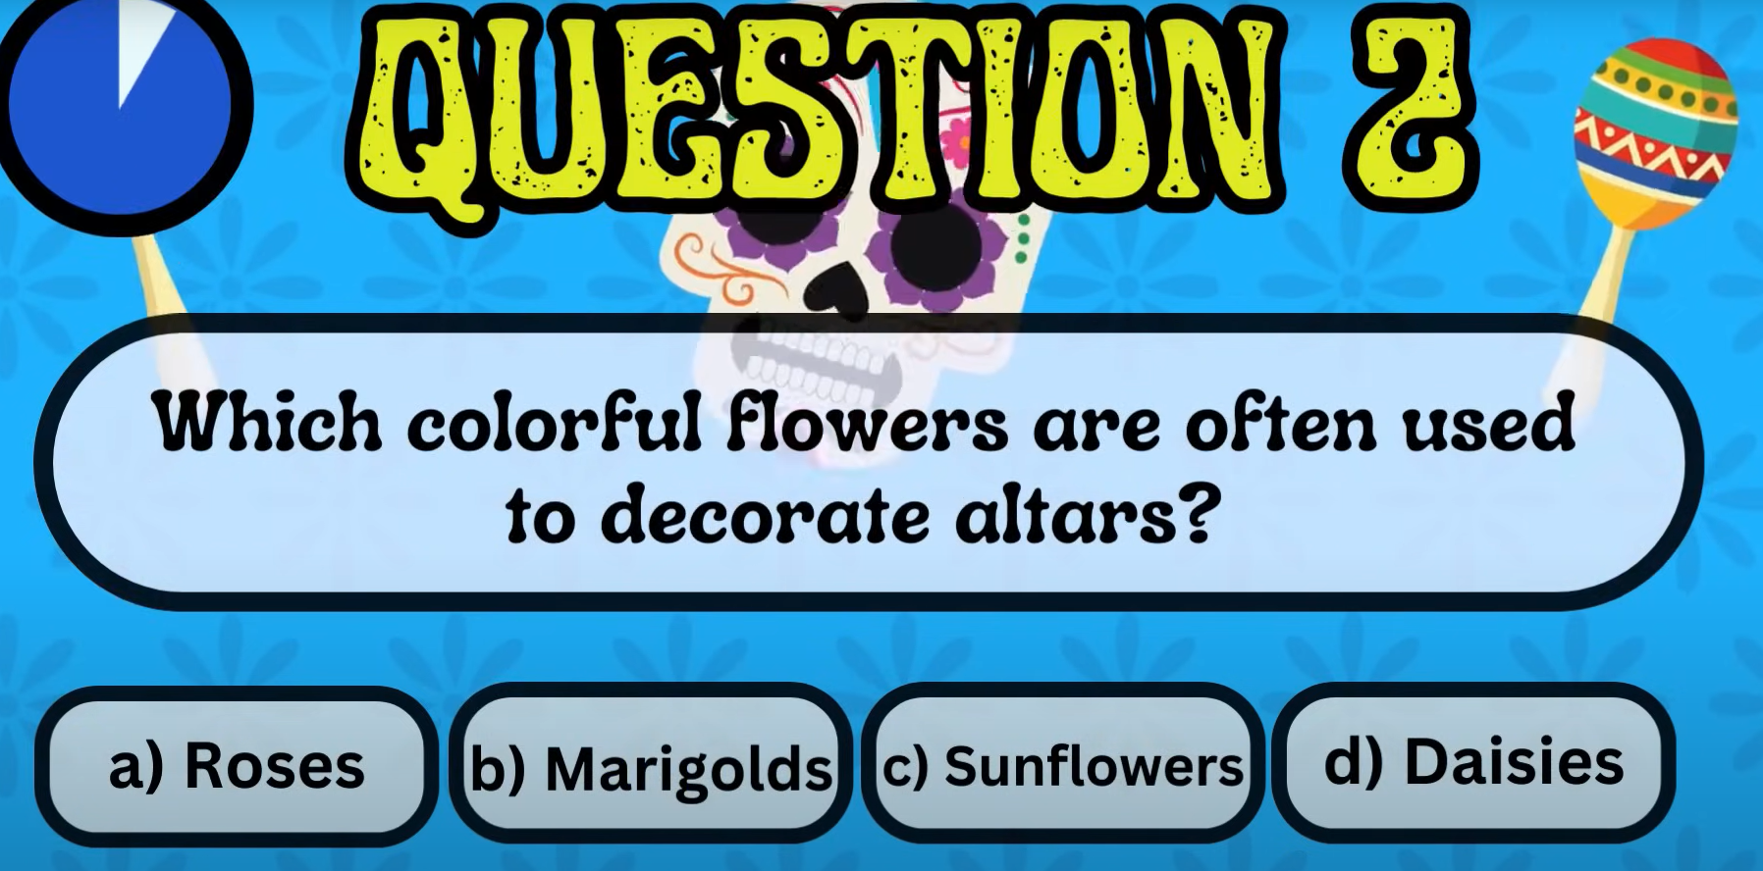
Día de los Muertos
Día de los Muertos

Slide 8
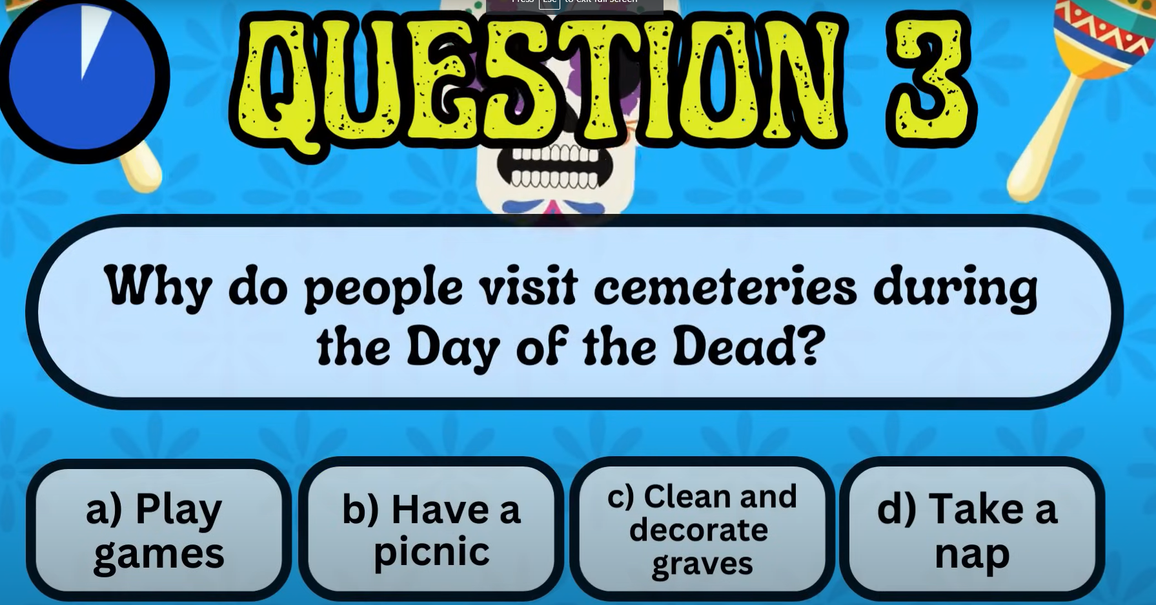
Día de los Muertos
Día de los Muertos

Slide 9
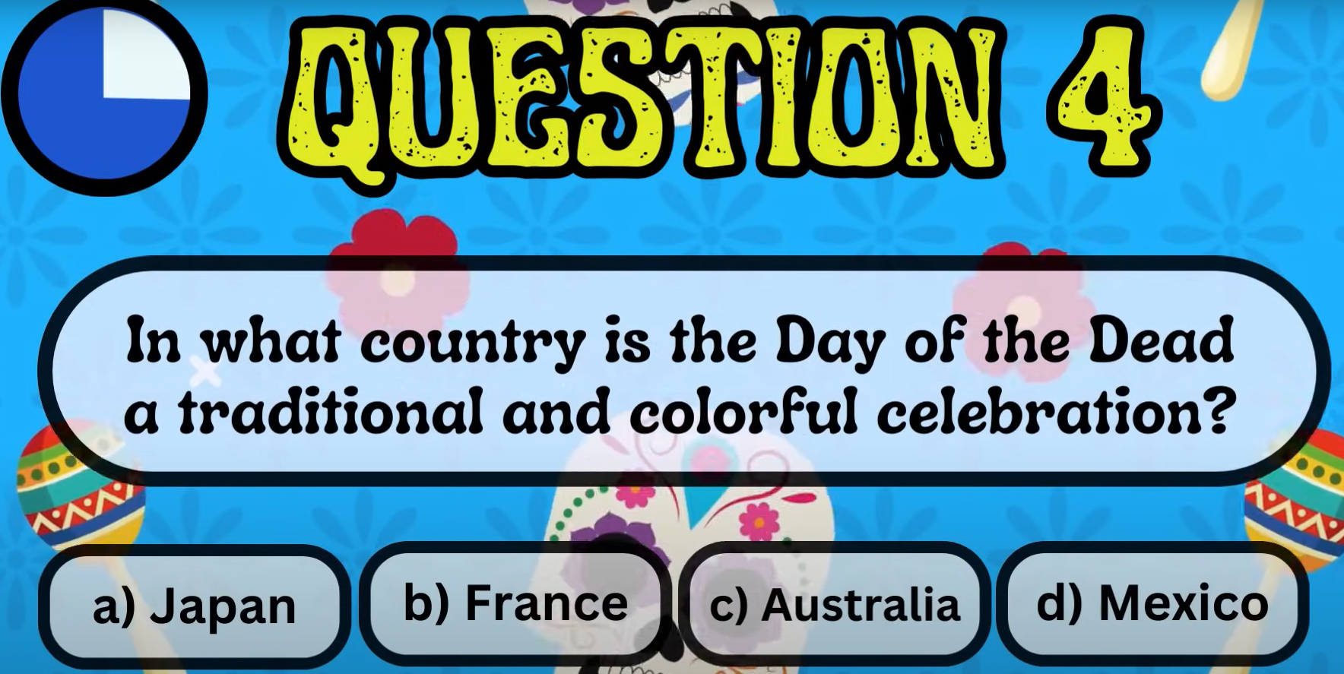
Día de los Muertos
Día de los Muertos

Slide 10
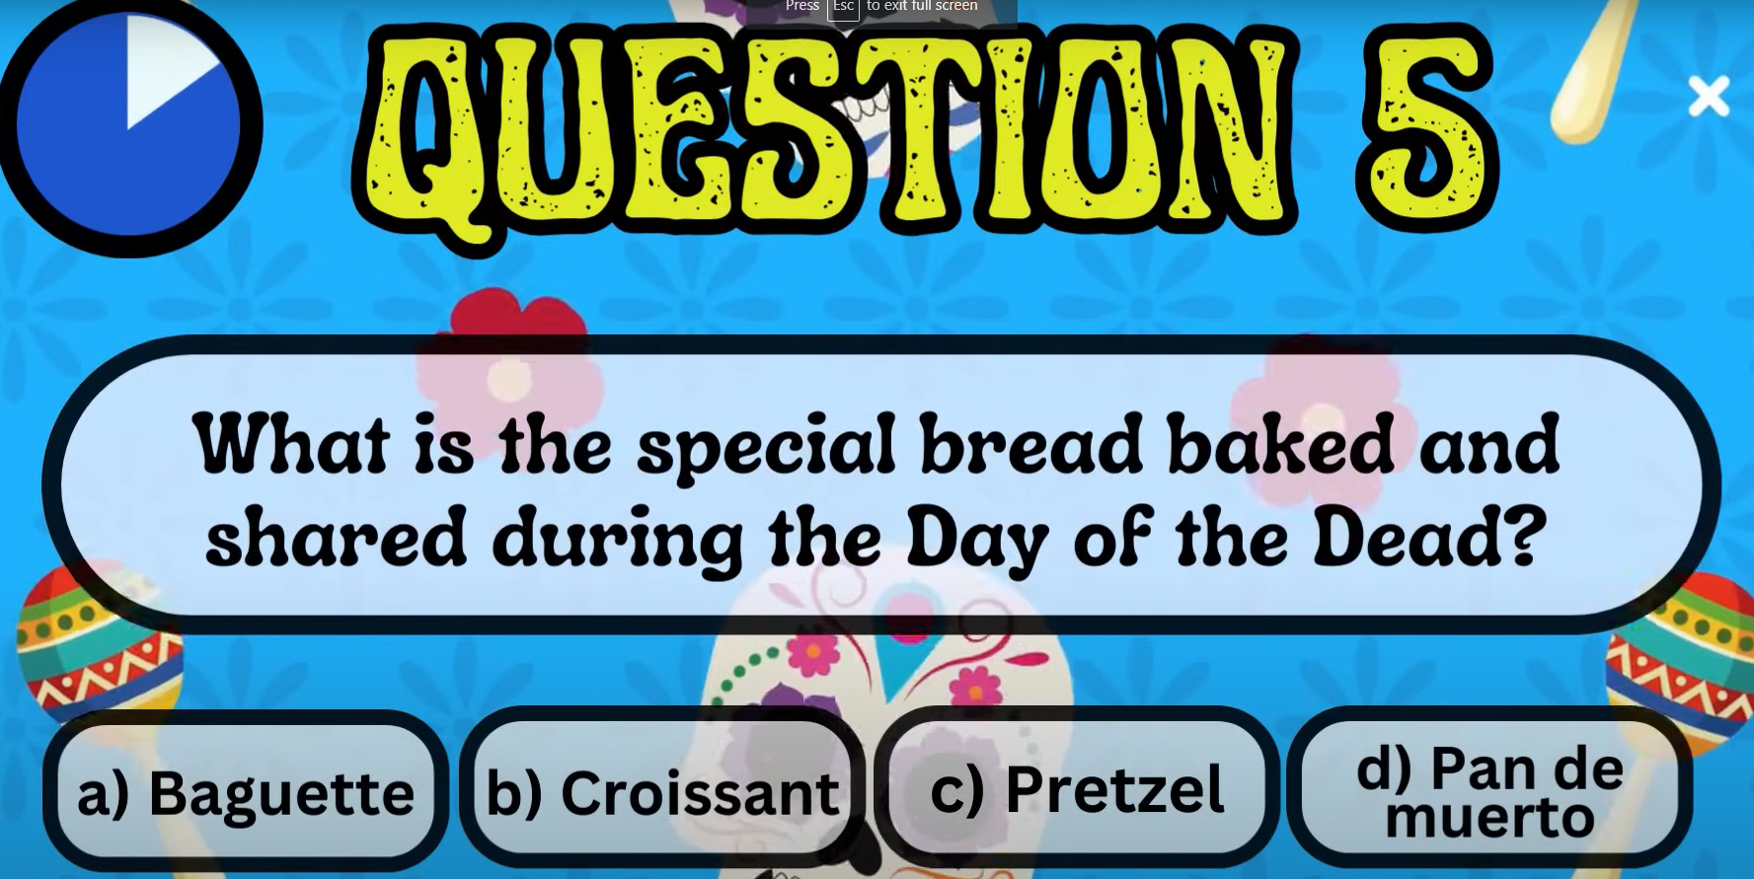
Día de los Muertos
Día de los Muertos

Slide 11
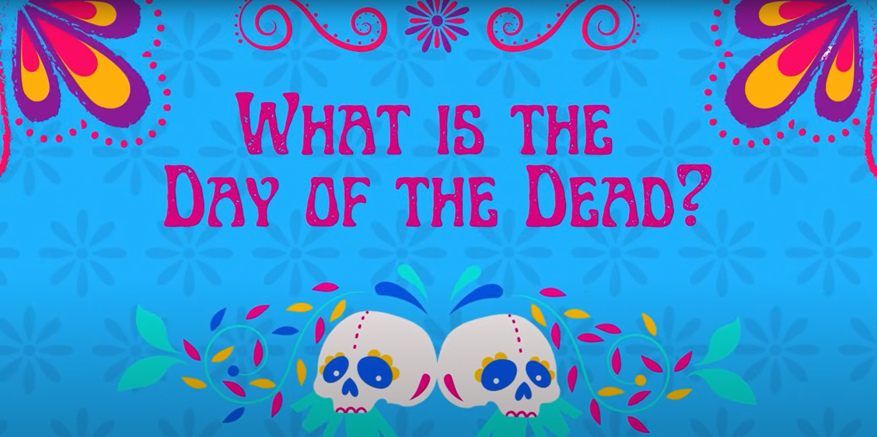
Día de los Muertos
Día de los Muertos
What is the day of the dead?
Why it is celebrated?
How is it celebrated?
Ofrendas & Altars ?
What is it’s history?
https://www.youtube.com/watch?v=o0_rNeK_R24

Slide 12
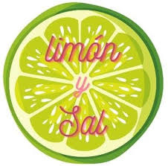
Storyteller /Cuentista/故事会-HW
Julieta Venegas - Limon Y Sal (Lyrics / Letra English & Spanish)

Slide 13
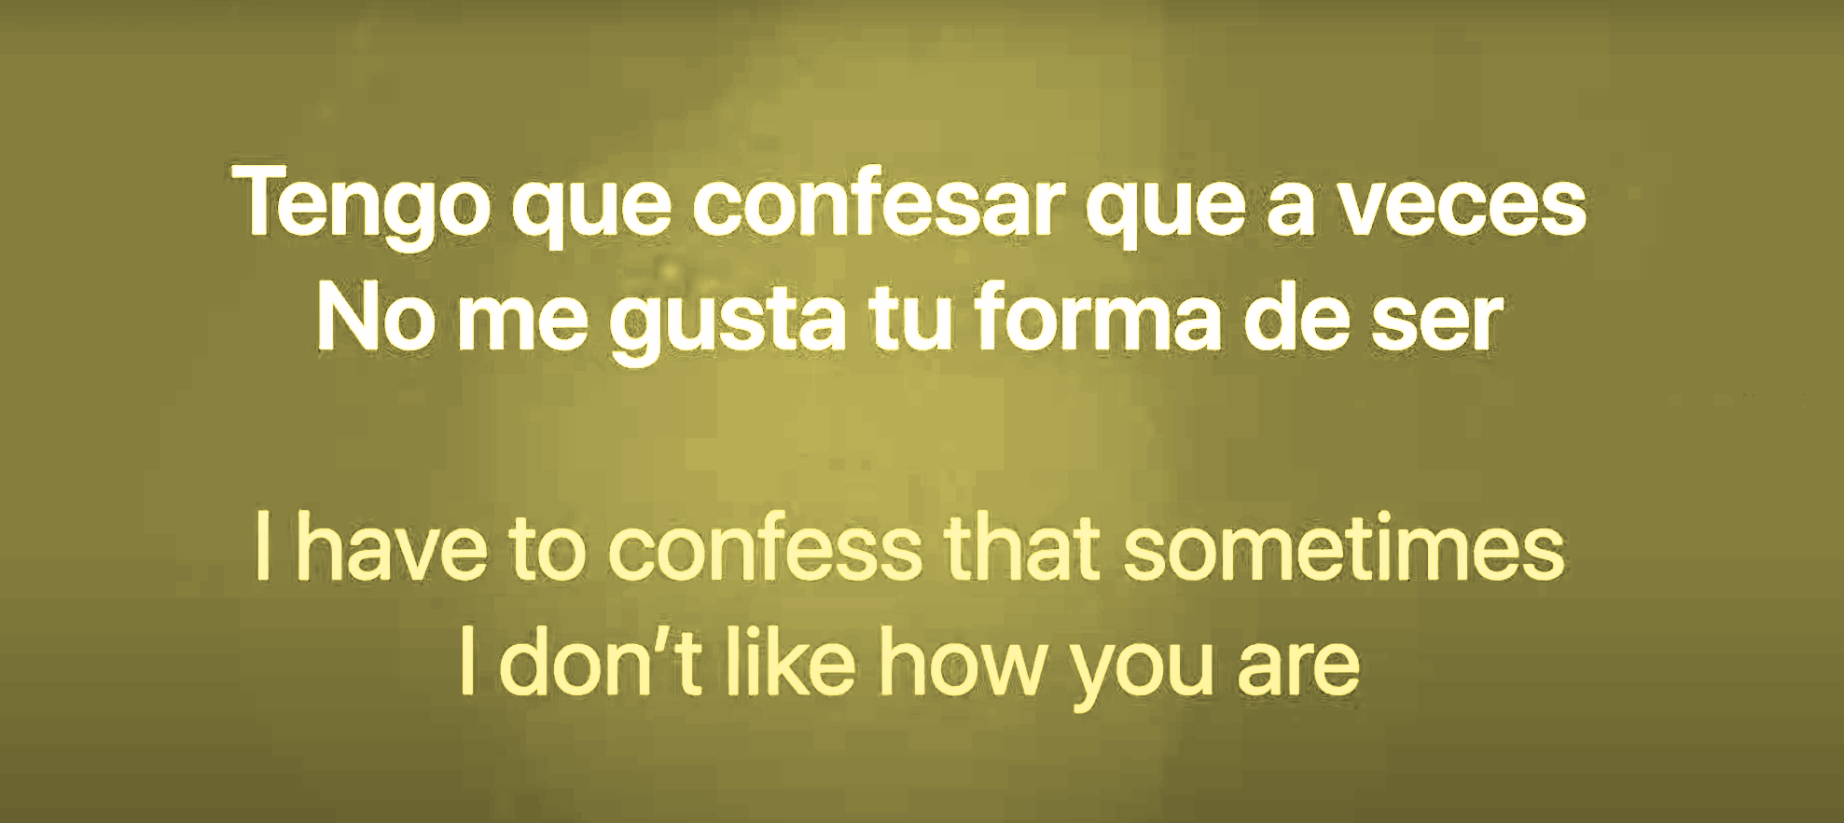
Storyteller /Cuentista/故事会-HW

Slide 14
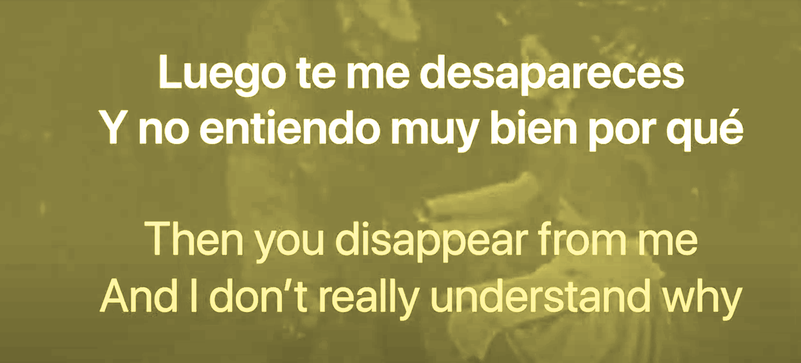
Storyteller /Cuentista/故事会-HW

Slide 15
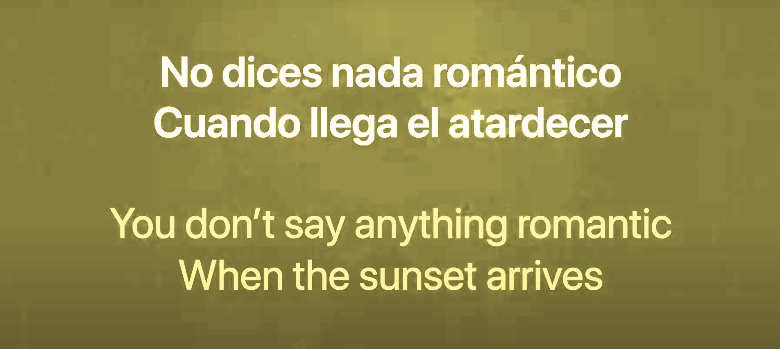
Storyteller /Cuentista/故事会-HW

Slide 16
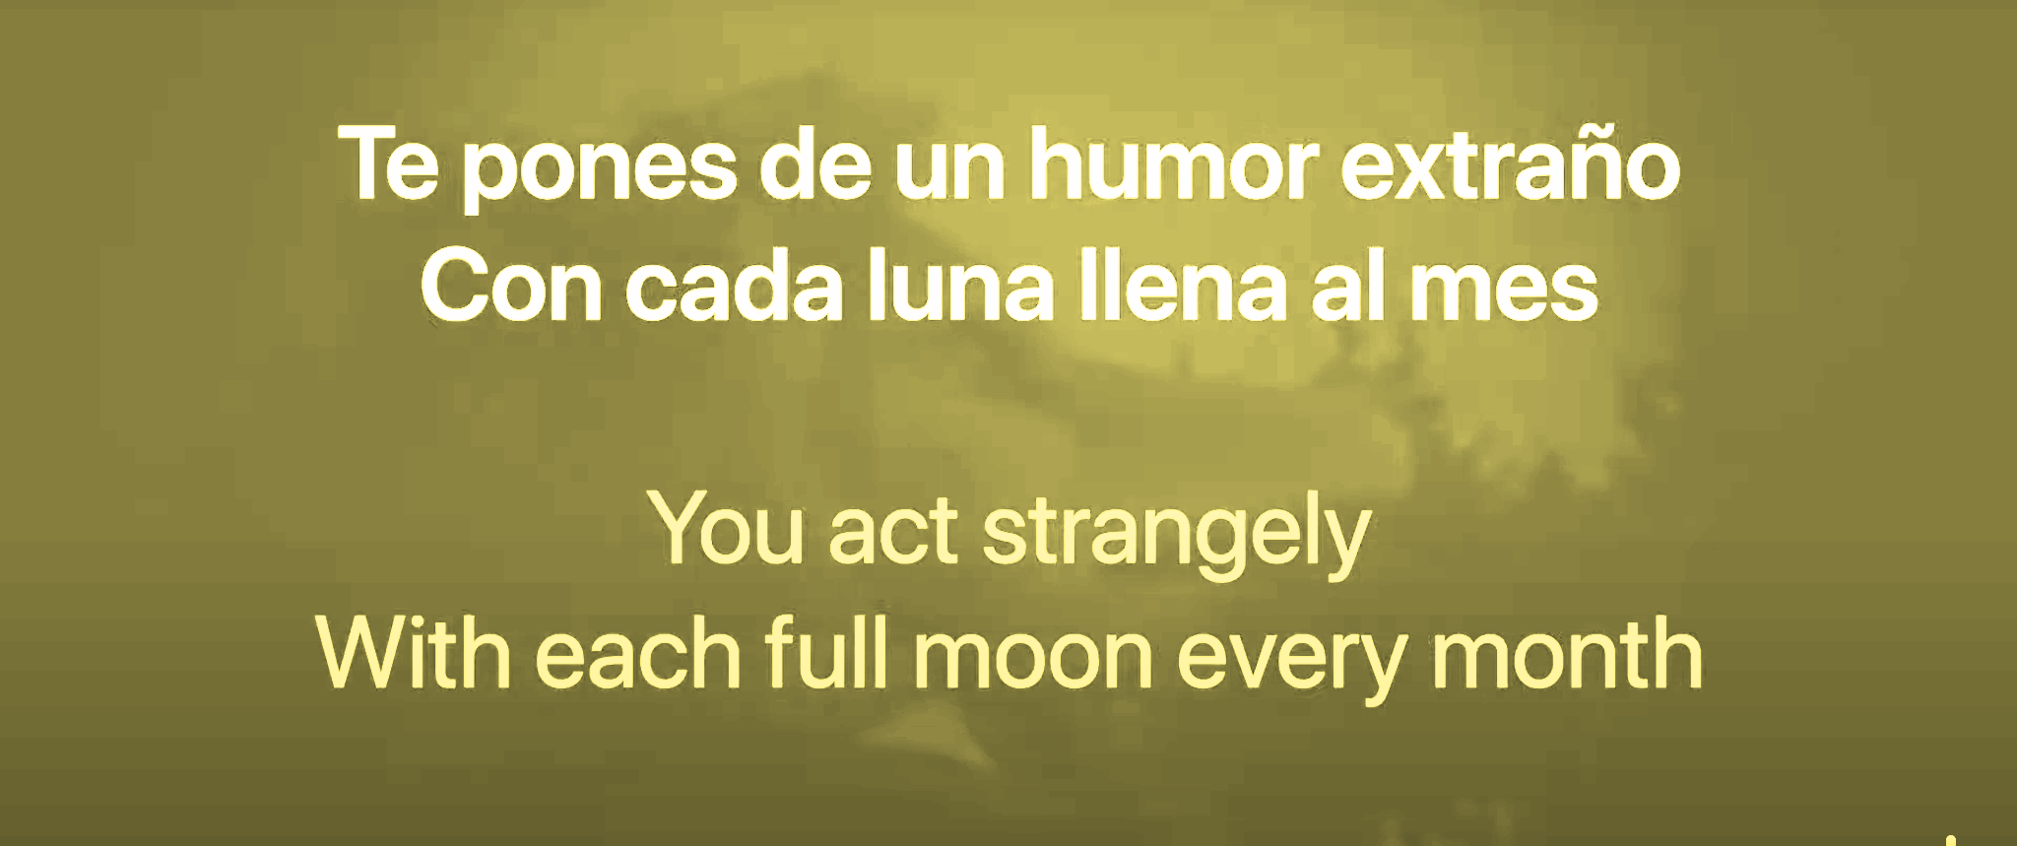
Storyteller /Cuentista/故事会-HW

Slide 17
Storyteller /Cuentista/故事会-HW

Slide 18
Storyteller /Cuentista/故事会-HW

Slide 19
Storyteller /Cuentista/故事会-HW

Slide 20
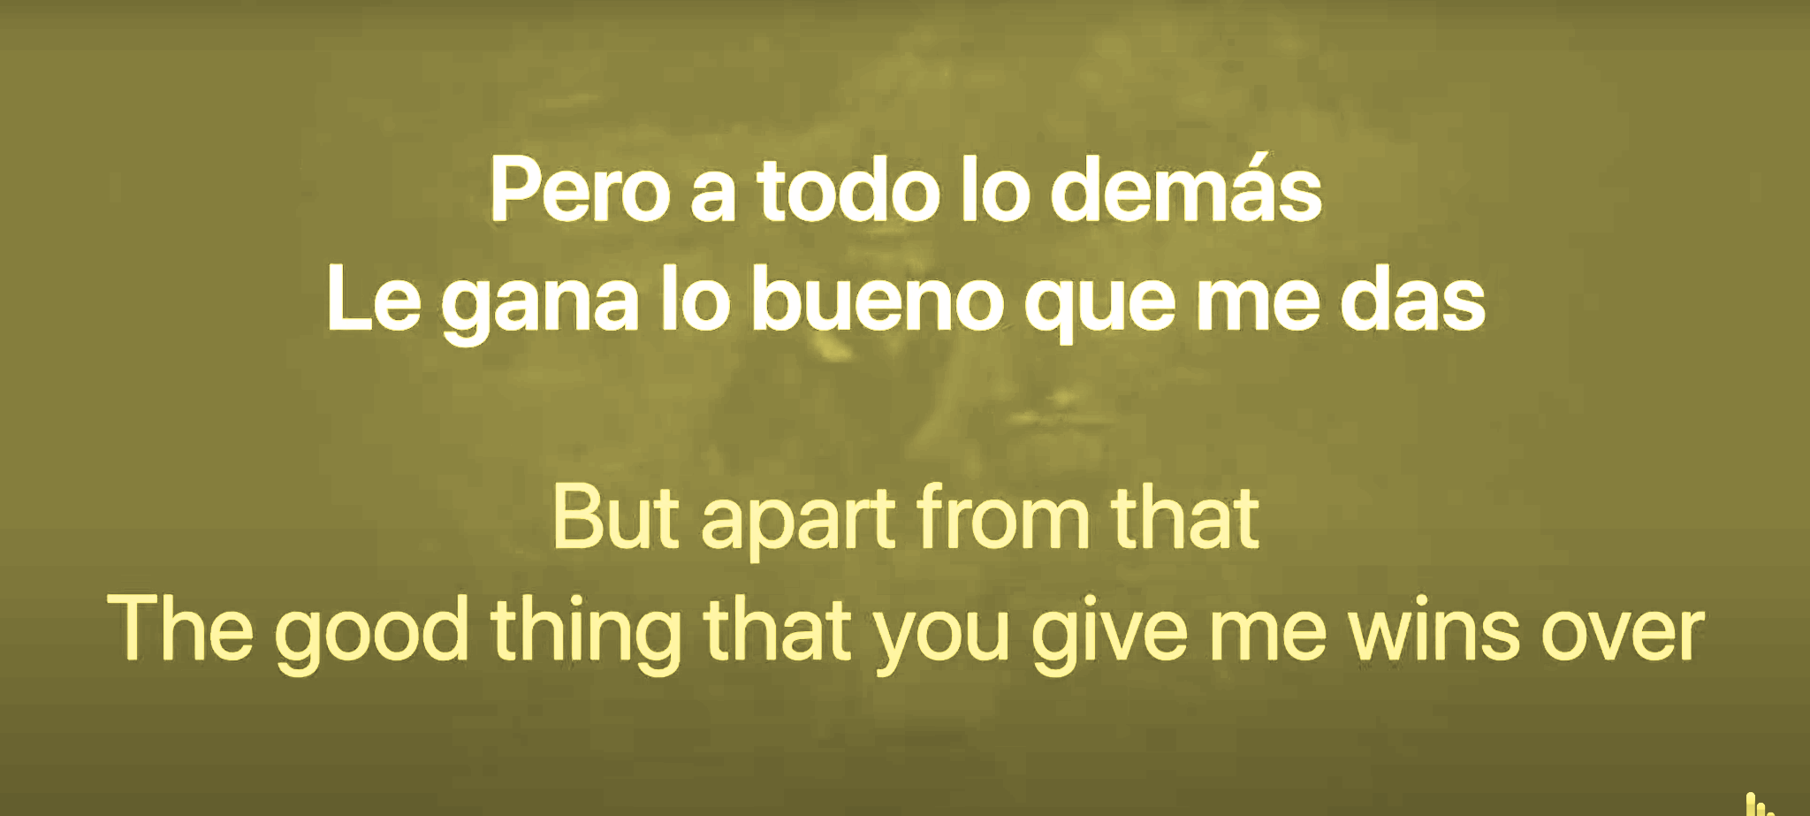
Storyteller /Cuentista/故事会-HW

Slide 21
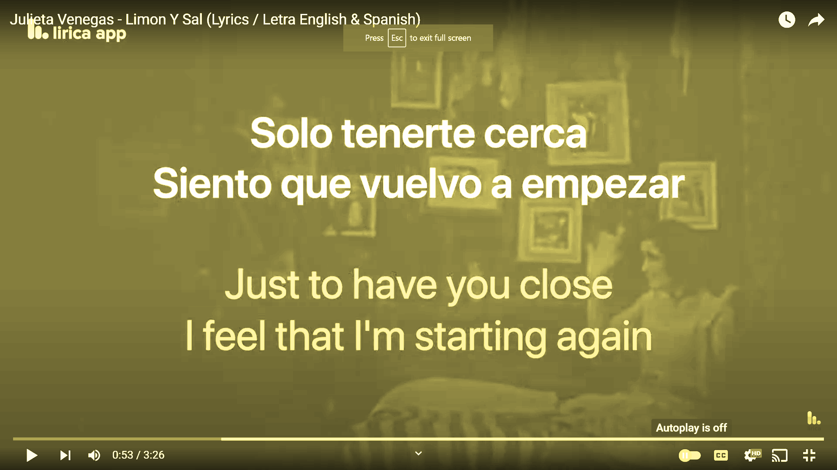
Storyteller /Cuentista/故事会-HW

Slide 22
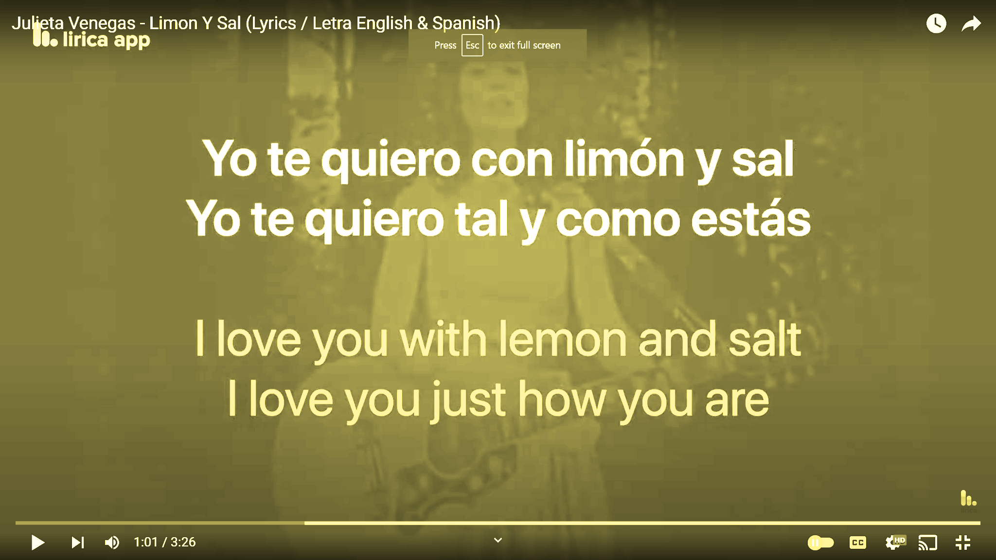
Storyteller /Cuentista/故事会-HW

Slide 23
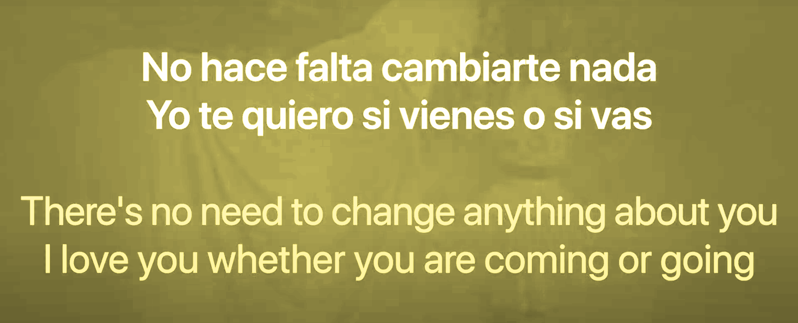
Storyteller /Cuentista/故事会-HW

Slide 24
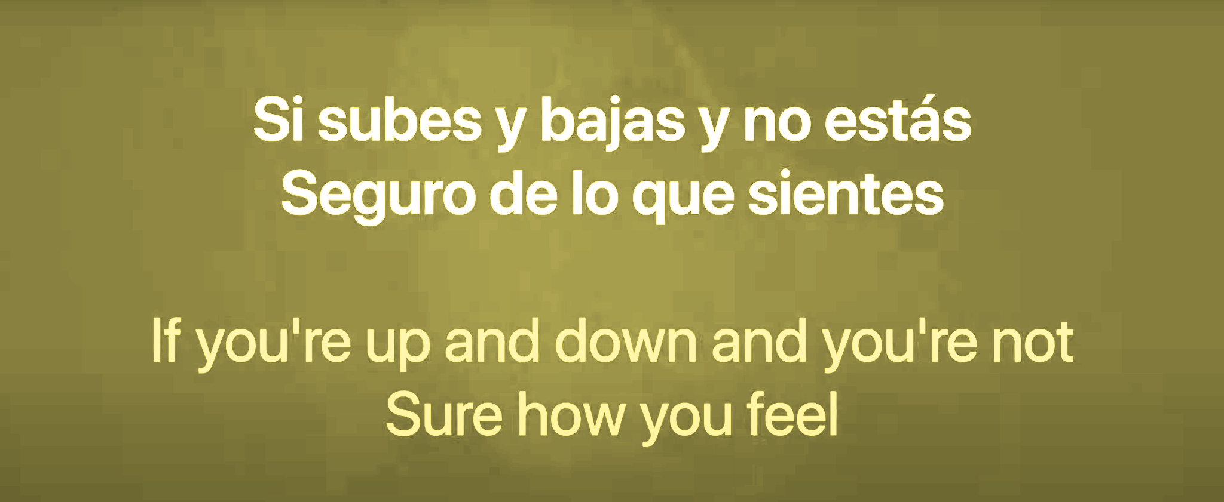
Storyteller /Cuentista/故事会-HW

Slide 25
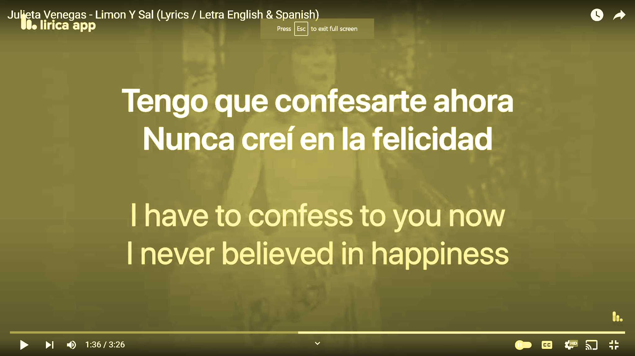
Storyteller /Cuentista/故事会-HW

Slide 26
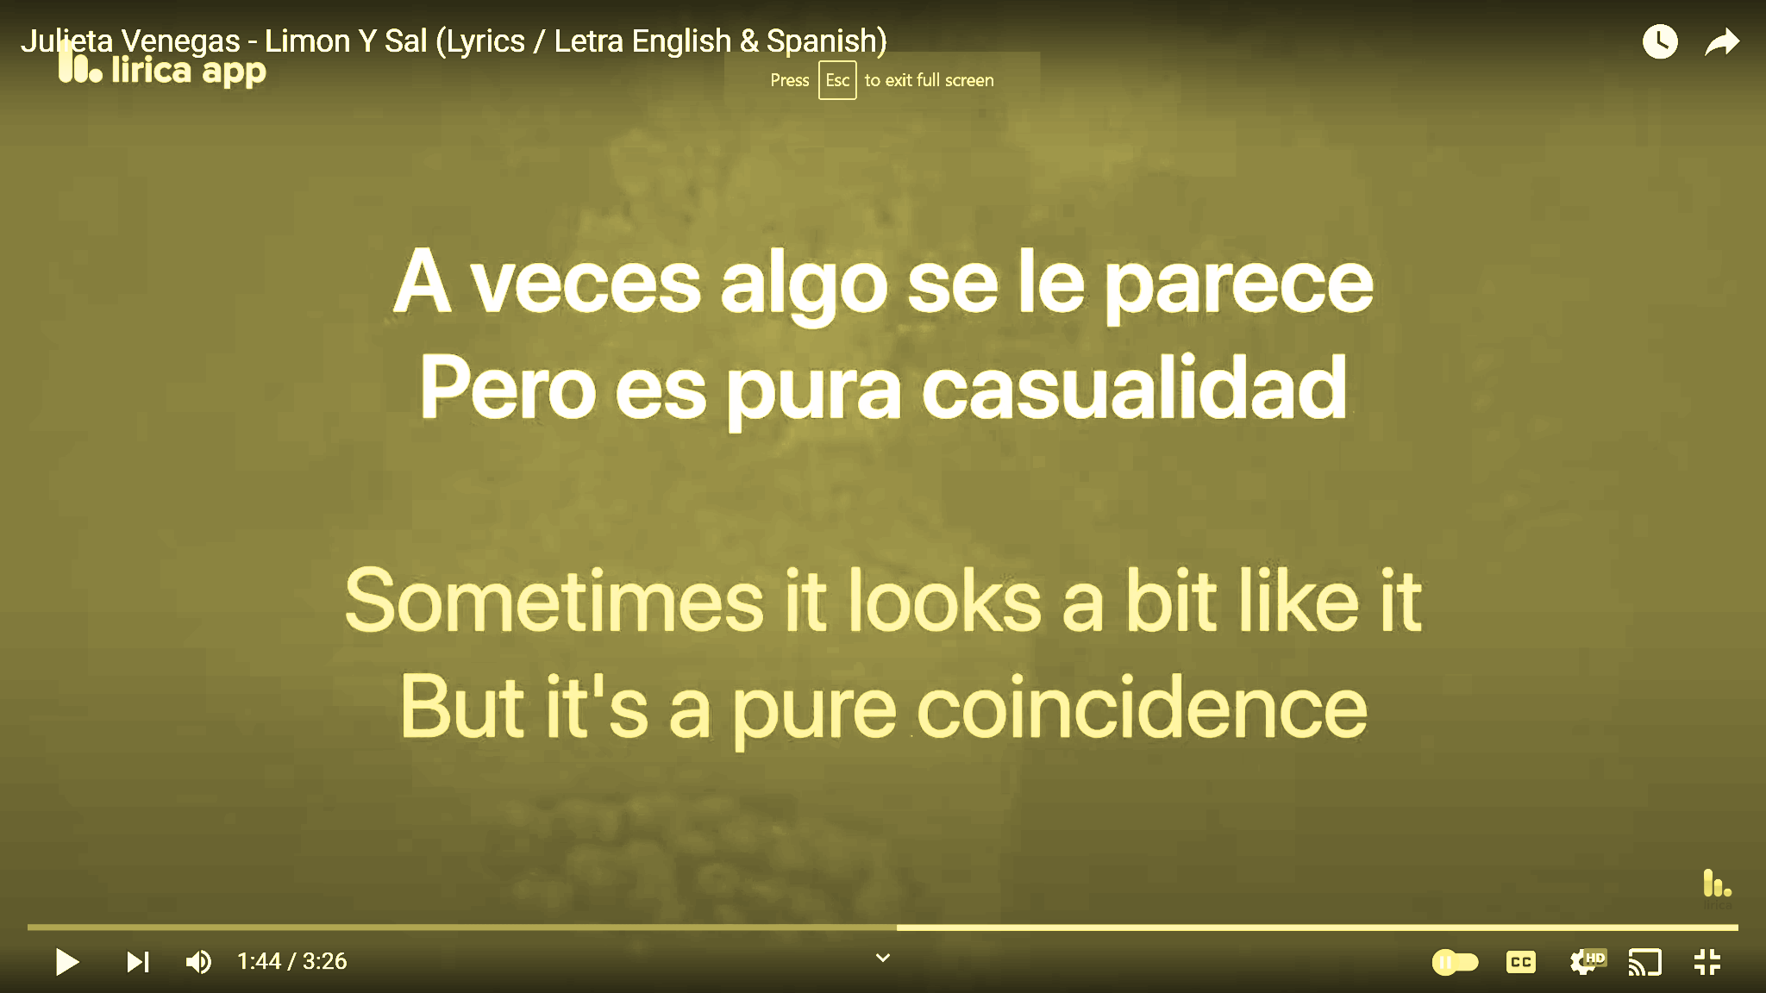
Storyteller /Cuentista/故事会-HW

Slide 27
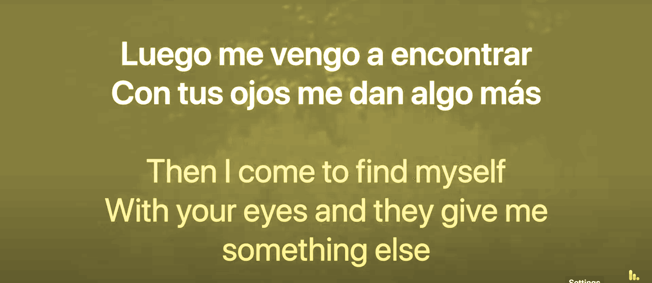
Storyteller /Cuentista/故事会-HW

Slide 28
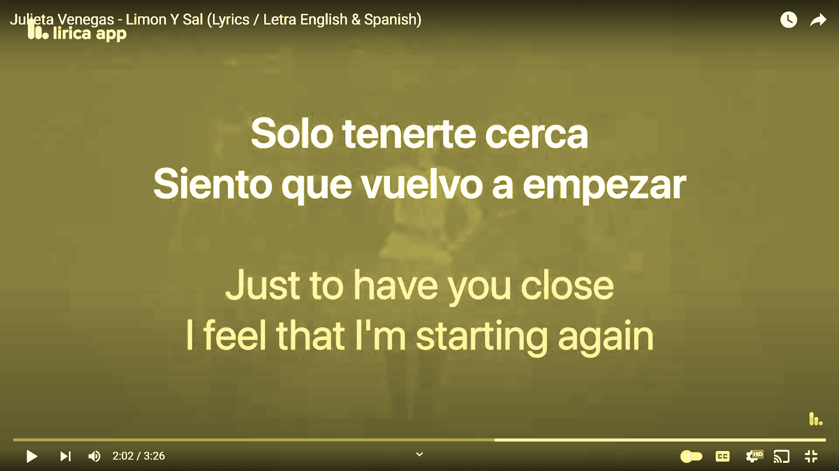
Storyteller /Cuentista/故事会-HW

Slide 29
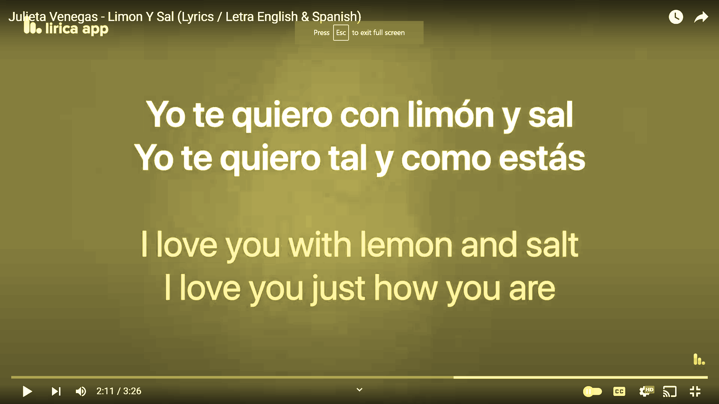
Storyteller /Cuentista/故事会-HW

Slide 30
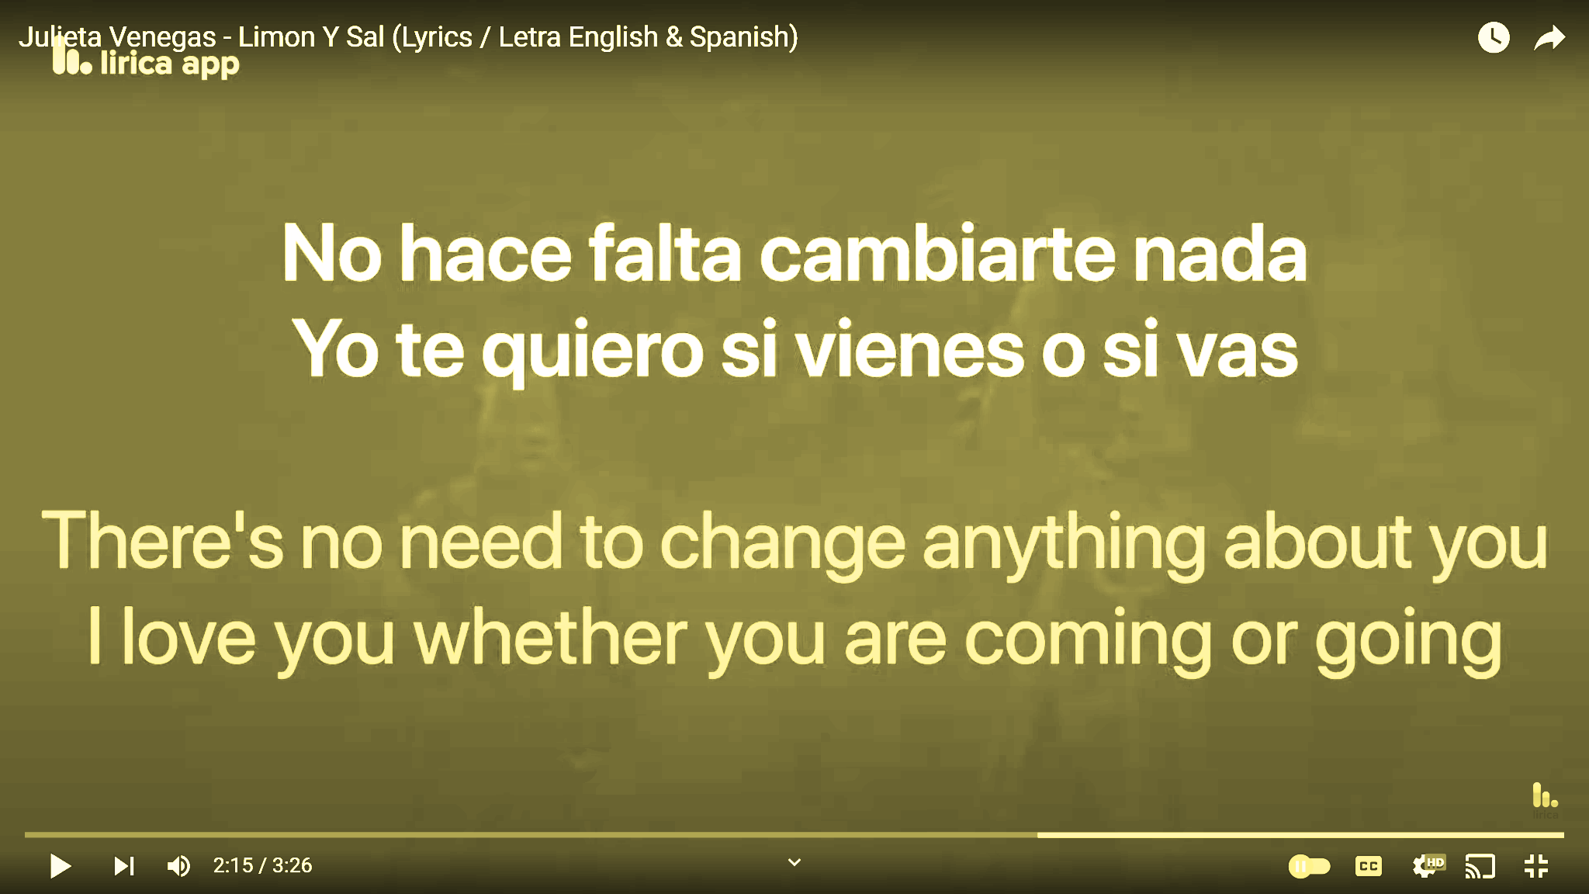
Storyteller /Cuentista/故事会-HW

Slide 31
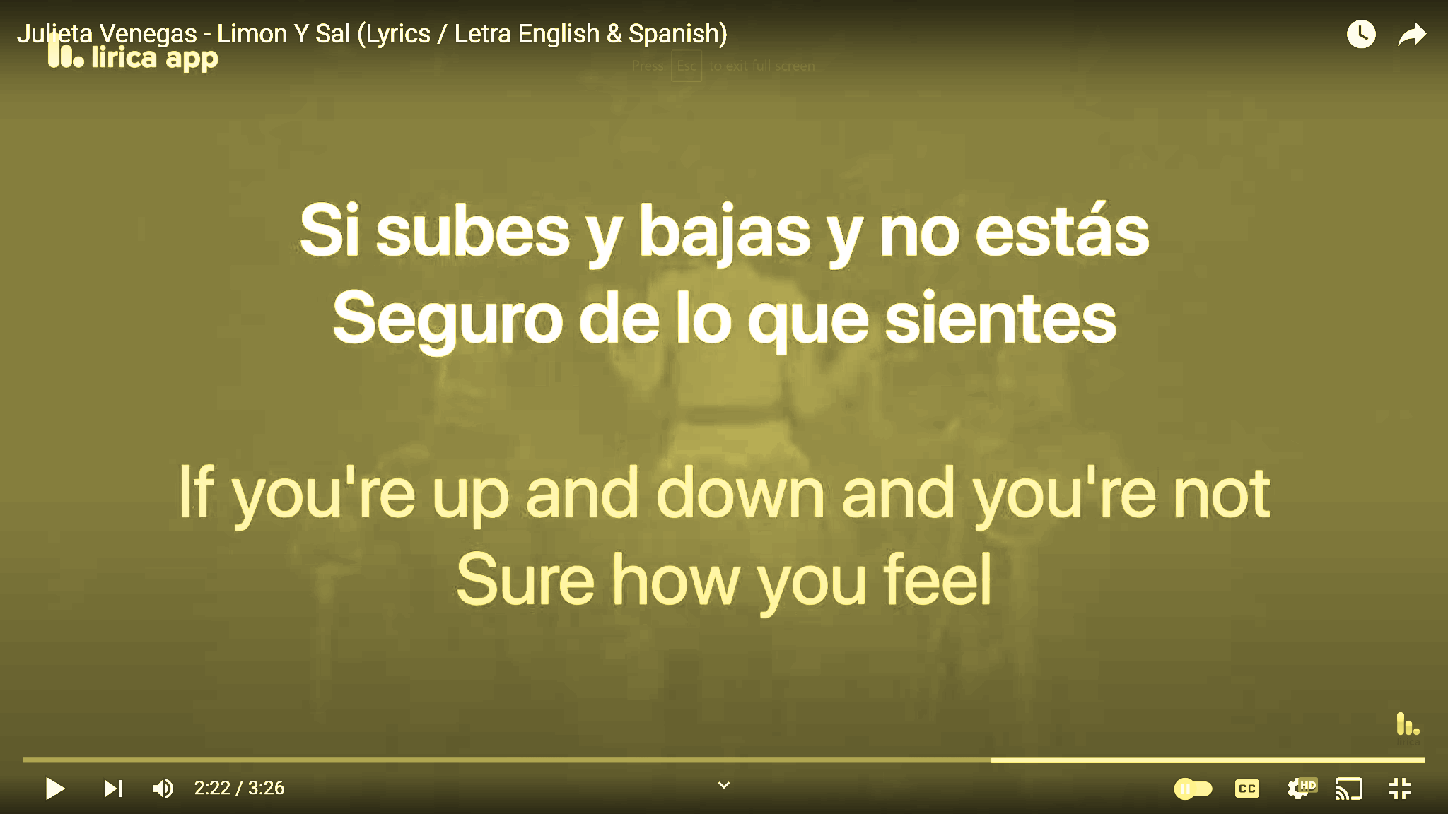
Storyteller /Cuentista/故事会-HW

Slide 32
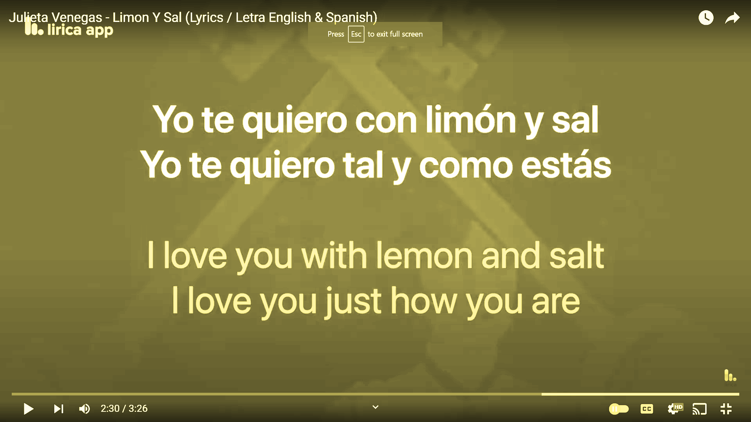
Storyteller /Cuentista/故事会-HW

Slide 33
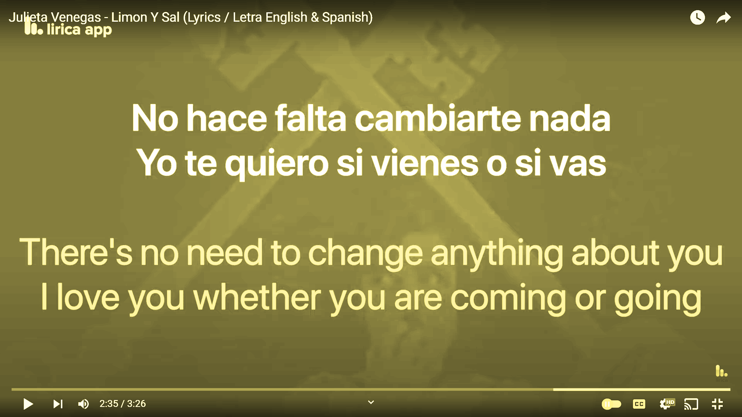
Storyteller /Cuentista/故事会-HW

Slide 34
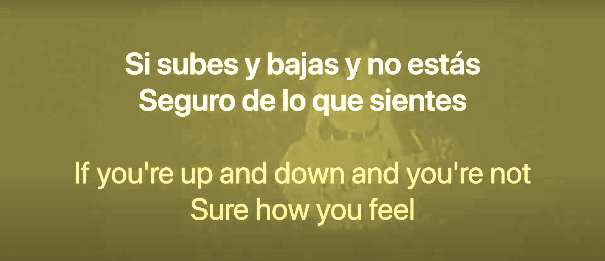
Storyteller /Cuentista/故事会-HW

Slide 35
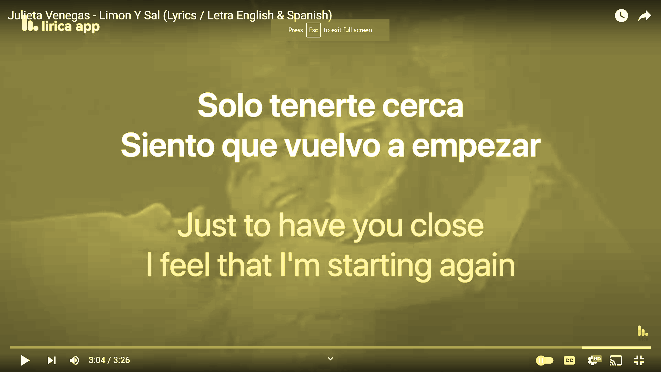
Storyteller /Cuentista/故事会-HW

